Slide 1

Improve I/O scalability for SDDP algorithm with MPI/IO/Lustre

Slide 2

Summary
INTRODUCTION
EVALUATIONS
INITIAL CONCLUSIONS

Slide 3
aBSTRACT
Efficient I/O scalability is a critical challenge in parallel computing, particularly as modern high-performance systems continue to expand in both computational power and data volume. Traditional I/O strategies often become bottlenecks, limiting the overall efficiency of large-scale simulations and data-intensive applications. To address these issues, various techniques have been proposed, including asynchronous I/O, parallel file systems, and optimized data partitioning strategies. These approaches aim to enhance throughput, reduce contention, and improve load balancing across multiple processing units.Despite advancements in I/O management, many scientific computing applications still suffer from inefficiencies in handling large datasets. Parallel architectures must efficiently integrate computation and storage layers to avoid performance degradation, especially in distributed environments. Furthermore, the choice of programming models and middleware plays a crucial role in optimizing data transfer between processors and storage systems. The impact of these design choices becomes even more significant when dealing with stochastic and iterative algorithms, which require frequent access to large datasets. A particularly relevant example of this challenge arises in mathematical optimization models such as Stochastic Dual Dynamic Programming (SDDP). These models rely on iterative evaluations over large datasets, requiring efficient I/O strategies to scale across multiple computational nodes. Poorly optimized I/O can severely impact the convergence speed and overall feasibility of solving complex stochastic problems. As a result, improving I/O scalability in parallel computing is not only a technical necessity but also a fundamental requirement for enabling large-scale mathematical models to operate efficiently.

Slide 4
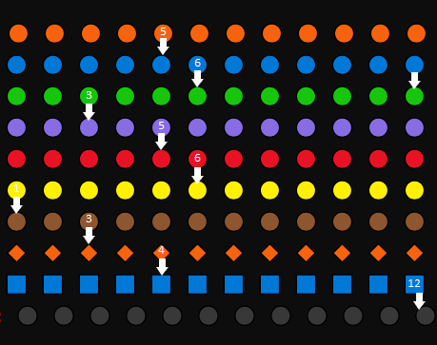
Introduction - The SDDP Algorithm
Used in operation planning.
Temporal dependency.
The number of scenarios is the number of processes that can run simultaneously.
Example problem: 10 stages and 12 scenarios.
10 X 12 = 120 lines per result.
Tests with 1 stage.

Slide 5
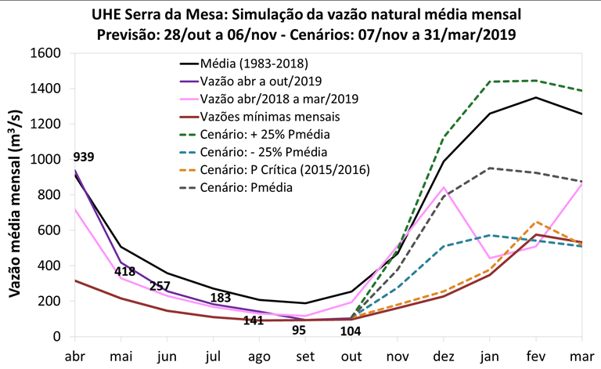
Introduction – what’s scenarios ?

Slide 6
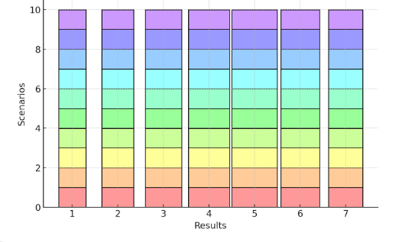
Introduction - Results
Examples of results: Fuel cost projection, thermal generation price projection
Different number of blocks per result.
Each process writes to a specific region of the file.
Examples of results: Fuel cost projection, thermal generation price projection.

Slide 7
Evaluation – case study
PMO BRASIL
Monthly: 1200 Scenarios
Hourly: 100 Scenarios
Stakeholders: ONS, Banks, Generators.

Slide 8
Evaluation – cluster configuration
16 nodes
Up to 3.2 GHz 4th Generation Intel Xeon Scalable processor (Sapphire Rapids 8488C)
32 Cores and 64 Hyper Theads.
64 GiB of ram memory per machine
Network bandwith 20 Gb/s

Slide 9
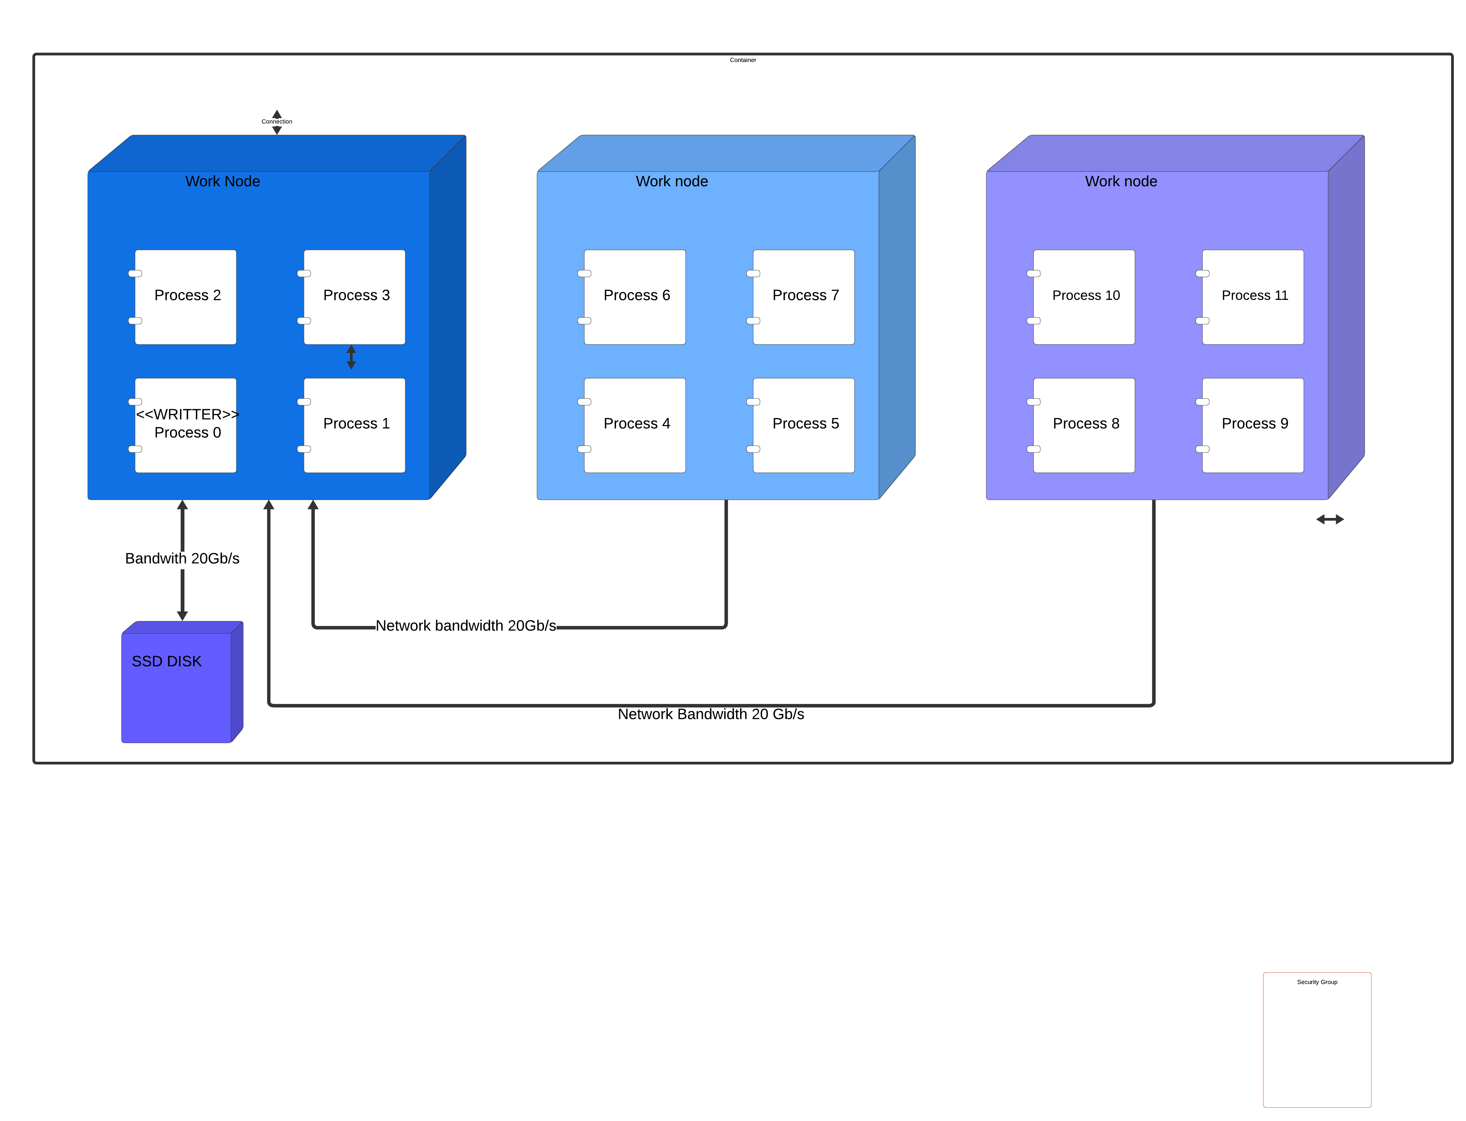
Introduction - cluster architecture
Notes:
Letras brancas e fontes maiores

Slide 10
Evaluation:
Test | Scenarios | Average(s) | Stdev(s) | Comunication time(s) | Total time(s)
1 node | 6
2 nodes | 12 | 0,000958 | 0,006271 | 0,285
4 Nodes | 24 | 0,0049552 | 0,010698 | 1,473
8 Nodes | 48 | 0,186381 | 0,460219 | 55,382
16 Nodes | 96 | 0,884963 | 1,525884 | 262,898
Nodes (*) | 1200
2000 Nodes (*) | 12000
(*) Estimation based on the average band.

Slide 11
Background: Stack hpc
Increase scalability.
Remove unnecessary decoupling of nodes.
Remove writer process with central point of failure.

Slide 12
Background: Hd5
Increase scalability.
Remove unnecessary decoupling of nodes.
Remove writer process with central point of failure.

Slide 13
Background: MPI-IO e seus algoritmos
Increase scalability.
Remove unnecessary decoupling of nodes.
Remove writer process with central point of failure.

Slide 14
Background: lustre
Increase scalability.
Remove unnecessary decoupling of nodes.
Remove writer process with central point of failure.

Slide 15
Proposta de solução: lustre MPI-IO
Increase scalability.
Remove unnecessary decoupling of nodes.
Remove writer process with central point of failure.

Slide 16

Thanks
MBRCRUZ@COS.UFRJ.BR

